Slide 1


—
Administrative Law 2025
Week 6 Judicial Review
Dr Richard Taylor
Lecturer, School of Law

Slide 2
Agenda
Hypothetical
What is standing?
01
02
Get your thinking about a problem to be solved
Introduction to the concept
Standing under ADJR
Joinder & Amicus Curae
03
04
Common law development of judicial review.
Statutory intervention in JR
Case Study: Adani
Problem Questions
05
06
What issues are suitable for JR
Questions to prepare for assessment
Notes:
Australia no bill of rights
Extra important admin law often only avenue of redress

Slide 3
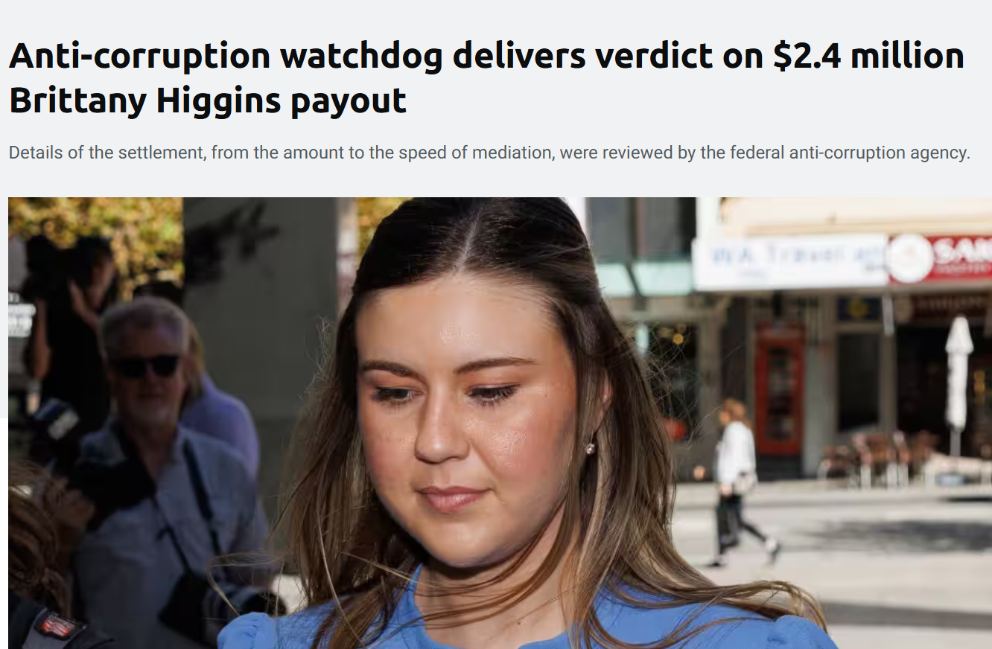
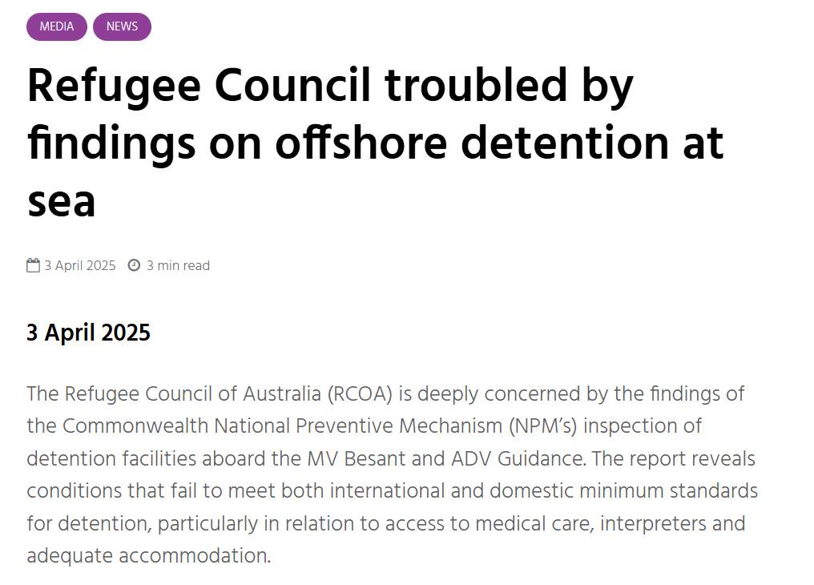
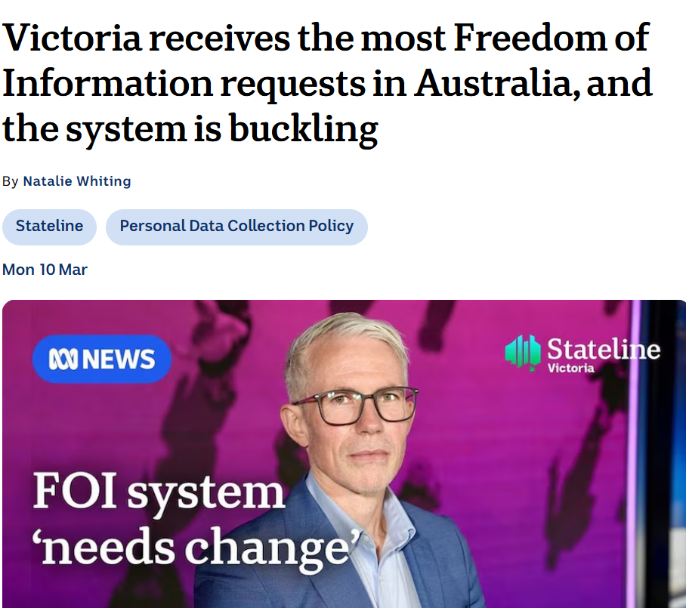
Administrative Law in the News [To be updated each week]
Anti-corruption watchdog delivers verdict on $2.4 million Brittany Higgins payout | SBS News
Refugee Council troubled by findings on offshore detention at sea
Victoria receives the most Freedom of Information requests in Australia, and the system is buckling - ABC News
Administrative Law –LAW1023

Slide 4


Hypothetical
The local council in the North East Shark Bay area have introduced a shark culling program following a fatal shark attack. An expert shark culling team have challenged the council’s decision to appoint a local culling team. The council says that the local team is the only team with sufficient experts to distinguish between endangered and non-endangered species of shark. The Conservation of Sharks Advocacy Group promotes the protection all sharks in the public interest.
Can they join? Do they have standing?
Administrative Law –LAW1023

Slide 5
Questions
1. What is standing or locus standi?
2. Why does it exist? What is its purpose?
a. Do you find these justifications plausible?
Notes:
Australia no bill of rights
Extra important admin law often only avenue of redress

Slide 6
Questions
3. Why are there rules relating to standing?
4. What is the criterion that must generally be satisfied in order to have standing?
5. In groups: Identify the contribution that the following cases make to the rules of standing 9identify what the facts were and what was held as a minimum:
Australian Conservation Foundation v Commonwealth (1980) 146 CLR 493
Onus v Alcoa of Australia Ltd (1981) 149 CLR 27
Bateman’s Bay Aboriginal Land Council v The Aboriginal Community Benefit Fund Pty Ltd (1998) 194 CLR 247
Shop Distributive and Allied Employees Assoc v Minister for Industrial Affairs (SA) (1995) 183 CLR 552
Australian Institute of Marine and Power Engineers v Sec, Department of Transport (1986) 71 ALR 73
North Coast Environmental Council v Minister for Resources (1994) 127 ALR 617
Right to Life Assoc (NSW) v Sec, Commonwealth Department of Human Services and Health (1995) 128 ALR 258
Notes:
Australia no bill of rights
Extra important admin law often only avenue of redress

Slide 7
Questions
6. What are purely commercial interests?
7. Consider Argos Pty Ltd v Corbell (2014) 254 CLR 394
a. What were the facts?
b. What was held?
8. In what circumstances do trade unions have standing?
9. What is joinder and amicus curiae?
10. What is the Attorney-General’s fiat?
11. Is the law relating to standing coherent?
a. How would you improve it?
Notes:
Australia no bill of rights
Extra important admin law often only avenue of redress

Slide 8
Attorney-General’s fiat
If a private individual is unable to demonstrate a special interest not shared by the rest of the community, they lack standing. An individual may sue to protect public rights in the name of the Attorney-General if that individual obtains the Attorney- General‘s fiat.
The Attorney- General has standing ex officio (by virtue of his or her office) to seek an injunction to protect public rights. The resulting action is called a relator action, because the plaintiff sues in the Attorney-General‘s name (ex relatione AG), and has the conduct of the action.
The Attorney- General‘s refusal to grant a fiat cannot be subject to judicial review: Gouriet v Union of Post Office Workers [1978] AC 435
Question: Explain the importance of Re McBain; Ex parte Australian Catholic Bishops Conference (2002) 209 CLR 372, for the use of the Attorney General’s Fiat.
Administrative Law –LAW1023

Slide 9
Joinder and amicus curiae
Joinder: A joinder is given in cases where the issues or parties involved overlap to give rise to a common question of fact or law, and all rights to relief claimed are in respect of, or arise from, the same transaction or series of transactions. A joinder can also be given at the discretion of the court.
The purpose of a joinder is to hear matters concurrently where it will increase efficiency and/or fairness.
An amicus curiae, or ‘friend of the court’, is a person or entity who appears in court in relation to a matter to assist the court without being a party to the proceeding. It is different to an intervenor as they are not a party to the proceeding and are not seeking a particular outcome; they are merely helping to facilitate the court processes.
Question: In what circumstances is the amicus curiae rule useful? Explain and give examples.
Administrative Law –LAW1023

Slide 10
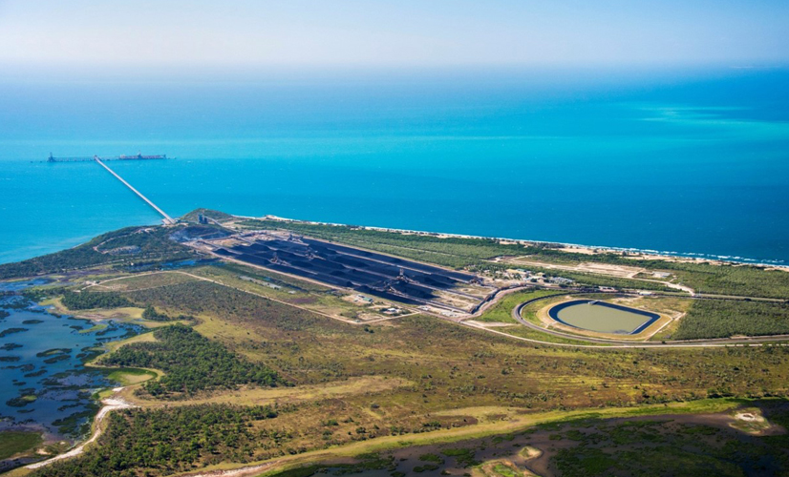
The Adani Saga
Administrative Law –LAW1023

Slide 11
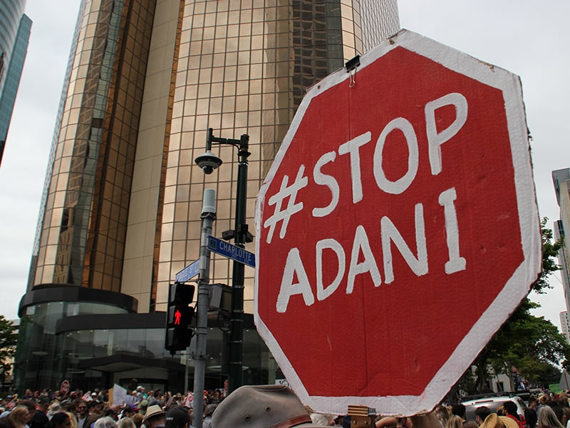
Adani Carmichael Coal Mine
The Carmichael coal mine is a coal mine in Queensland, Australia. Owned by the Adani Group, construction began in July 2019.
The mine has drawn criticism for its environmental impacts on the Great Barrier Reef, water usage and carbon emissions. Other contentious issues are its claimed economic benefits, financial viability and use of taxpayer funding
In addition to the enormous political campaign against the mine and its financial difficulties, it has faced multiple court cases. Some of those cases that have received heavy media coverage. Those cases are not the focus of this case study but are explained below to minimise confusion over the different cases against this mine and associated infrastructure.
https://commonslibrary.org/
Administrative Law –LAW1023

Slide 12
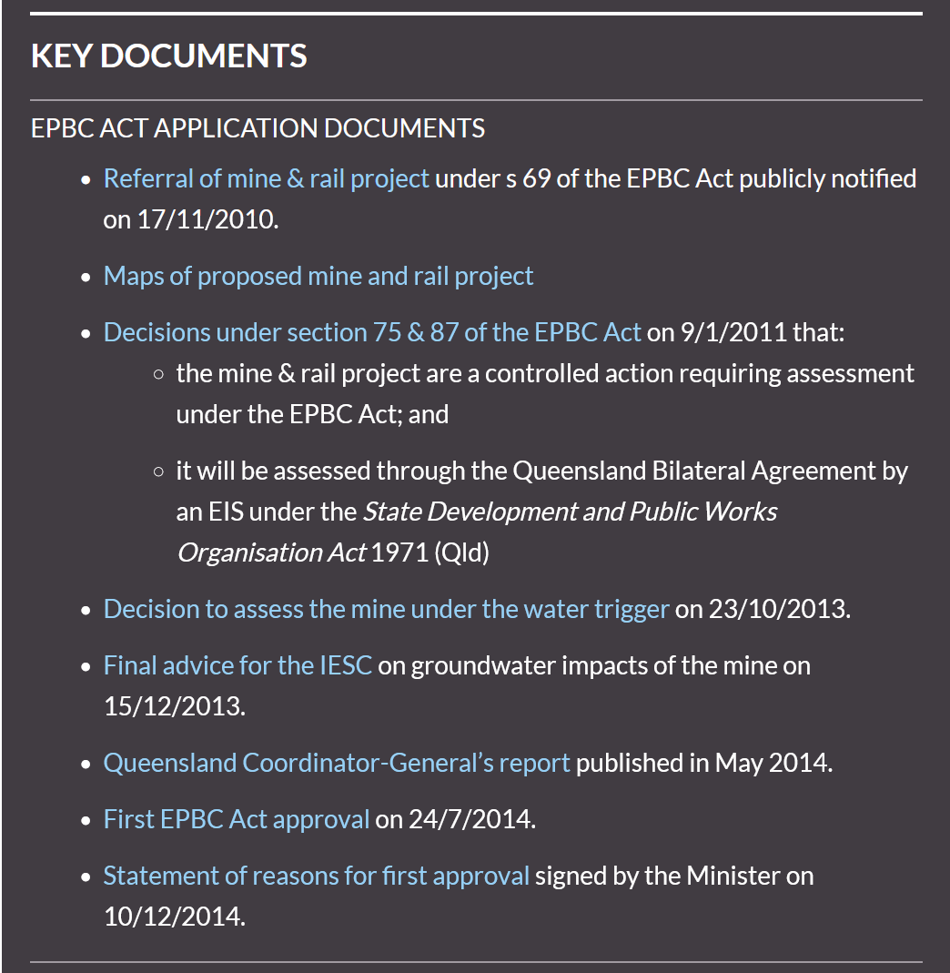
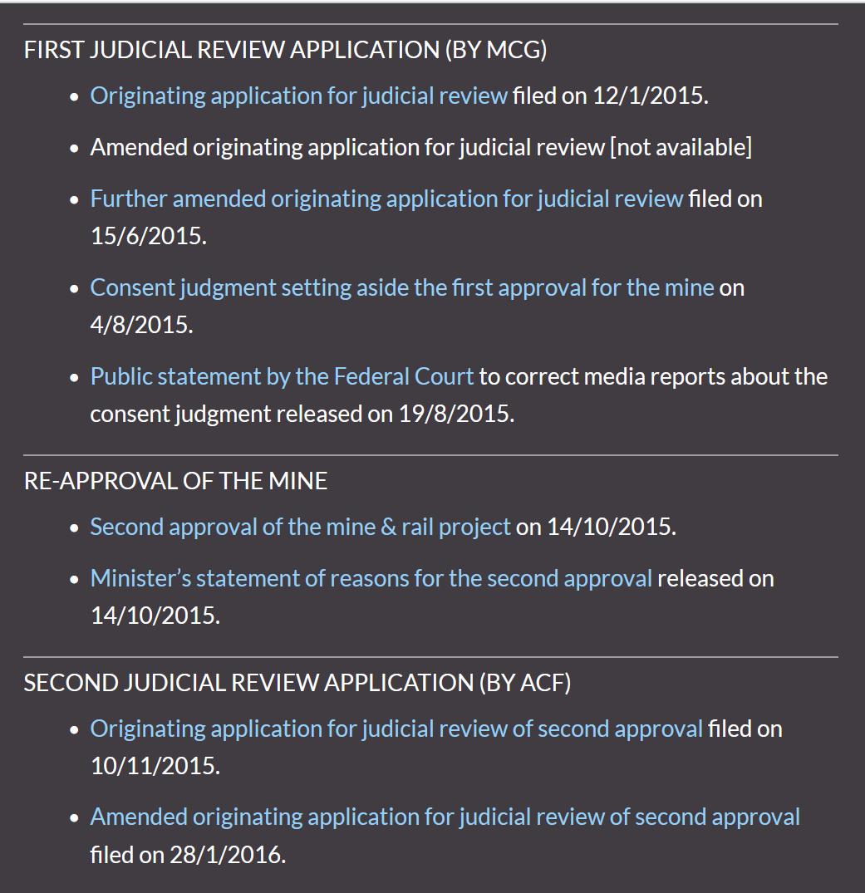
Interaction with State EIA processes the Adani Carmichael Mine and Rail Case
Source: http://envlaw.com.au/carmichael-coal-mine-federal-court/
Administrative Law –LAW1023

Slide 13

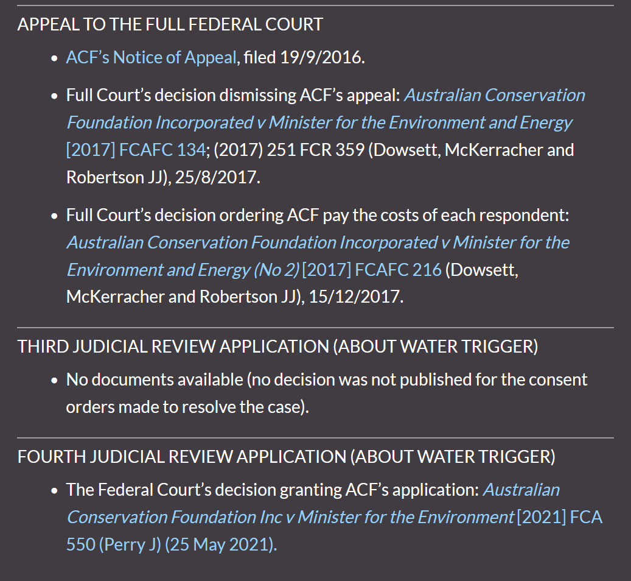
Interaction with State EIA processes the Adani Carmichael Mine and Rail Case
Source: http://envlaw.com.au/carmichael-coal-mine-federal-court/
Administrative Law –LAW1023

Slide 14
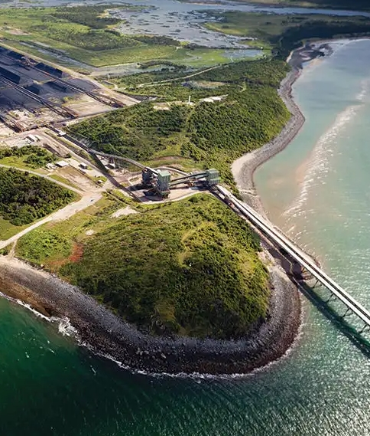
Other regulations
Native Title Act 1993 (Cth)
Must negotiate an Indigenous Land Use Agreement with native title holders
Several legal challenges made by the Wangan and Jagalingou People.
Aboriginal Cultural Heritage Act 2003 (Qld)
Must prepare a cultural heritage management plan
Minerals Resources Act 1989 (Qld)
Applications for a mining lease
Environmental Protection Act 1994 (Qld)
a general environmental duty applies under s 319
An environmental authority (assessment and approval) must be obtained for various environmental impacts
Sustainable Planning Act 2009 (Qld)
Development assessment and approval required (planning approvals)
Water Act 2000 (Qld),
Water licences required for taking or interfering with water and various local water plans to be complied with
Vegetation Management Act 1999 (Qld)
Vegetation clearing must be assessed by DNRM –but exemption applies for mining activities
Nature Conservation Act 1992 (Qld)
Protection for endangered species and habitat –exemptions apply for mining
And more …..
Administrative Law –LAW1023
Source: Adani

Slide 15
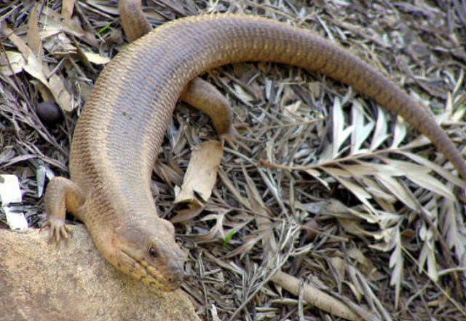
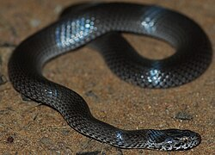
Adani Carmichael Coal Mine
The first application was brought by the Mackay Conservation Group in early 2015 in the Federal Court in Sydney.
No judgment was delivered but the Court later issued a statement that the parties agreed the Commonwealth Environment Minister had failed to consider approved conservation advices for two listed threatened species, the Yakka Skink and the Ornamental Snake, contrary to the requirements of section 139(2) of the EPBC Act.
Following the first approval for the mine being set aside, the Minister re-approved the mine under the EPBC Act.
Video report on 2015 Federal Court setback for Adani.
Administrative Law –LAW1023
Yakka Skink and Ornamental Snake Source: DEECA

Slide 16
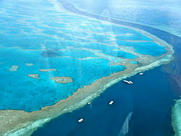

Adani Carmichael Coal Mine: The second judicial review application and appeal
The second application, brought by the Australian Conservation Foundation (ACF) in late 2015, alleged that the Minister failed to properly consider the impacts of the climate pollution from the mine on the Great Barrier Reef World Heritage Area.
The application was dismissed at first instance by the Federal Court. ACF appealed but was unsuccessful.
The court ruled in favour of the government, based on the argument that only considering the direct emissions from mining operations (and not the emissions caused by the burning of its coal) is a decision at the minister's discretion.
Source: Wikicommons
Administrative Law –LAW1023

Slide 17

Adani Carmichael Coal Mine: The third judicial review application
The third application was brought by the ACF on 4 December 2018. It was allowed by consent of all of the parties on 12 June 2019 – that is, ACF won.
CF alleged that the Minister, Melissa Price, erred by deciding that water use at the mine not directly involved in the extraction of coal did not require approval under the EPBC Act’s water trigger.
Through the proceedings it became evident that the process leading to the Minister’s approval hadn’t properly considered the more than 2,200 public submissions that had been made, with some even being lost.
As a result, the ACF amended the grounds to challenge the failure to consider those submissions and the Minister and Adani conceded, leading to ACF’s application for review being granted by consent- meaning the Australian Government would reassess the project’s water use.
Source: Wikicommons
Administrative Law –LAW1023

Slide 18
Adani Carmichael Coal Mine: The fourth judicial review application
The fourth application was brought by ACF in 2020 against a decision by a delegate of the Minister. The application argued that the water pipeline should require assessment under the EPBC water trigger.
The federal court ruled in favour of the AFC in May 2021, thereby requiring the minister to reconsider the environmental impacts associated with the mine's water pipeline before it is approved.
Note: This decision does not stop the mine,. The Minister is merely required to reconsider the application according to law and is highly likely to again approve the water infrastructure for the mine.
Source: Wikicommons
Administrative Law –LAW1023

Slide 19
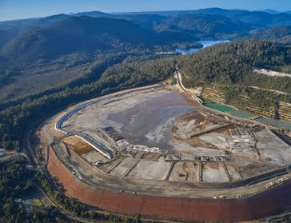
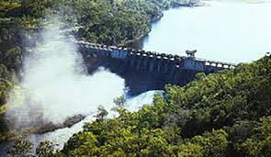
Problems with Judicial Review
Groundhog Day’ outcomes
Even if successful, decision can make the same decision again if the error with better reasoning, so the error can be corrected. At least the key issues can be publicised and the project commencement may be delayed (and sometimes cancelled).
Nathan Dam case - QCC v MEH (2003) -. A new dam proposal on Dawson River in Qld was likely to impact on the Great Barrier Reef –the Minister failed to take this into account –decision was set aside and he had to do it again and approved the dam with additional conditions
Tarkine National Coalition case (2013). Approval of a new mine in Tasmania failed to consider risks to Tasmanian Devil (road kill a huge problem) –challenge succeeded and then mine was approved with additional conditions.
Legal costs may be very high
Legal proceedings are expensive to run and government funding for public interest cases has been greatly reduced.
Many challenges are unsuccessful –and winner’s legal costs may be awarded against the losing party. Applicants may be excused from payment if the legal issues are of broad importance to the general community –the Oshlack principle applied in the Blue Wedges case (2008) re Port Phillip Bay dredging.
Source: Roseberry Mine (Tasmania) Tarkine
Source: ELA / Nathan Dam
Administrative Law –LAW1023

Slide 20

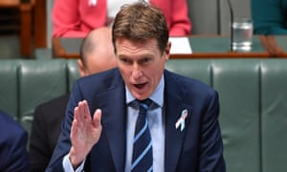
The Contested Concept of “Lawfare”
Environmental groups challenge decisions just to frustrate/delay. This is bad for the economy – reduces willingness to invest in Australia
Allows unelected judges to interfere in decisions made by democratically elected ministers.
Litigation funders taking advantage
No evidence that open standing significantly increases litigation – no evidence of ‘floodgates’
Generous standing protects ‘rule of law’ – ensures government cannot act outside legal limits of powers, irrespective of whether individual interests are harmed
Public interest in government acting within legal power
Administrative Law –LAW1023

Slide 21
Some media links
http://theconversation.com/the-government-vs-the-environment-lawfare-in-australia-46205
http://www.theaustralian.com.au/national-affairs/george-brandis-moves-to-end-lawfare-sabotage/news-story/17c875ed6b26ac342cae158e1b512231
https://www.theguardian.com/australia-news/2019/nov/15/australian-litigation-funding-giant-rejects-christian-porters-lawfare-claim

Slide 22
Problem Question
The Minister for the Environment has power to grant mining licenses. A number of companies have made applications for licenses to mine in areas of land adjacent to forests that are world heritage listed. The minister has rejected three applications on the basis that forest environments are too fragile, but has granted a licence to Forest Mines. The Minister sent a letter to this effect with reasons for the decision to each company. There is no provision in the relevant legislation to support an application for review of the decision by the ART. One of the unsuccessful companies, Pro Pristine Mines, who are well known for their detailed proposals to protect the soil, flora, fauna and water, wants to challenge the Minister’s decision.
Advise Pro Pristine Mines (PPM).
How would PPM challenge the decision?
Do they have standing to challenge the Minister’s decision not to grant Forest Mines a mining licence?
Administrative Law –LAW1023

Slide 23
Questions for Discussion
Do you think these post-ACF cases (particularly Argos, North Coast and Animals’ Angels) suggest that the courts’ approach to standing has evolved in the last 35 years?
Do you think the ADJR Act’s broad purpose of improving Government decision-making has influenced the courts to
relax the standing test(s)?
Can you think of any problems with requiring the interest to be one that is recognised
by the statute?
ALRC recommended in 2012 that ADJR include an equivalent
to s 27(2) AAT Act (refer back to Topic 4 slides on standing for
details) – why?
Administrative Law –LAW1023

Slide 24
—
Questions?
Email
richard.taylor2@rmit.edu.au

